Slide 1
TPO SITE
GROUP MEMBERS:
SARTHAK BANSAL -180075054
VAIBHAV G -18075062
SHUBHAGRA KASAV -18075057

Slide 2
Features available in Web application(website):
The Training & Placement Office is well equipped with excellent infrastructure to support each and every stage of the placement processes.
This site of the Institute centrally handles all aspects of campus placements for the graduating students of all Departments.
The Training & Placement Office provides the infra-structural facilities to conduct tests and interviews besides catering to other logistics.
It gives us immense pleasure to extend to you a most cordial invitation to participate in the Campus Recruitment Programme of the Indian Institute of Technology (BHU), Varanasi.

Slide 3
Front End in brief:
The template for the pages has been formatted accordingly to serve the purpose of our website
Use of HTML and CSS has been made in order to give it user-friendly and bright look so that the website looks attractive to the user.
It can also be used to describe situations where the Recruiter has access to one view and employees have access to another.

Slide 4
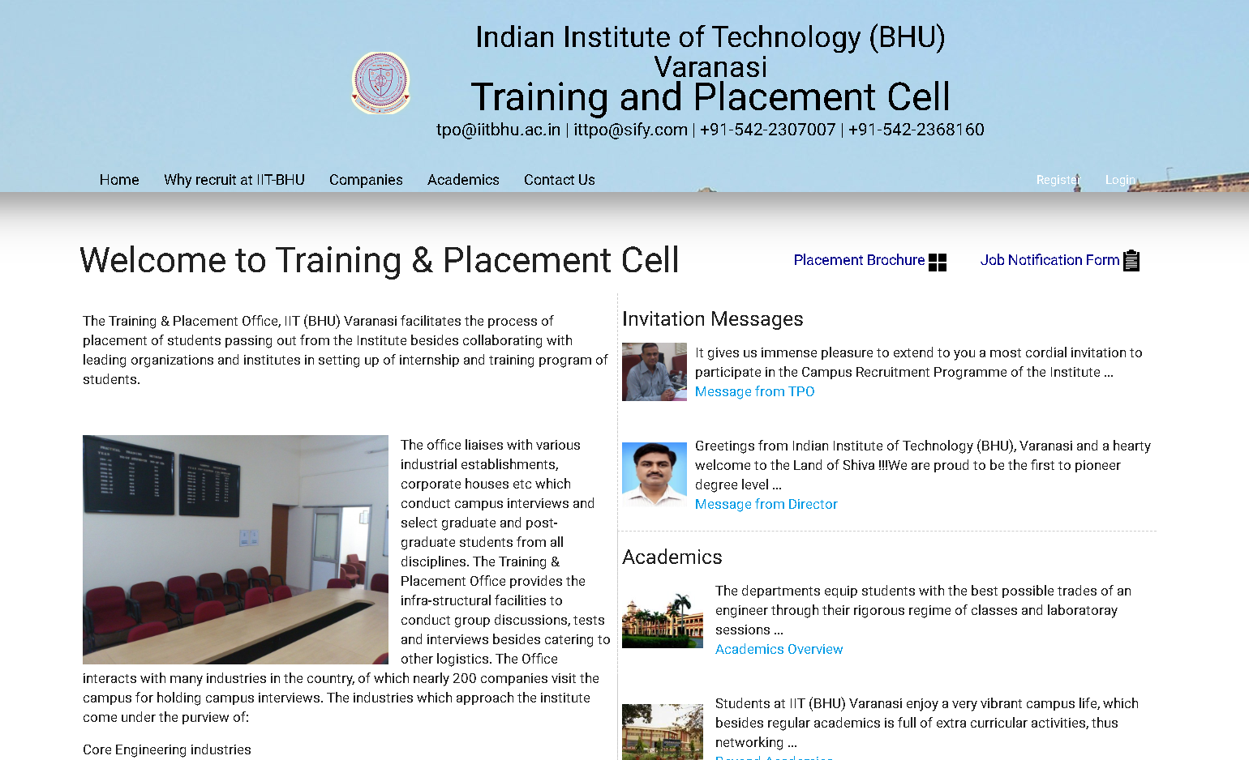
Homepage View:

Slide 5
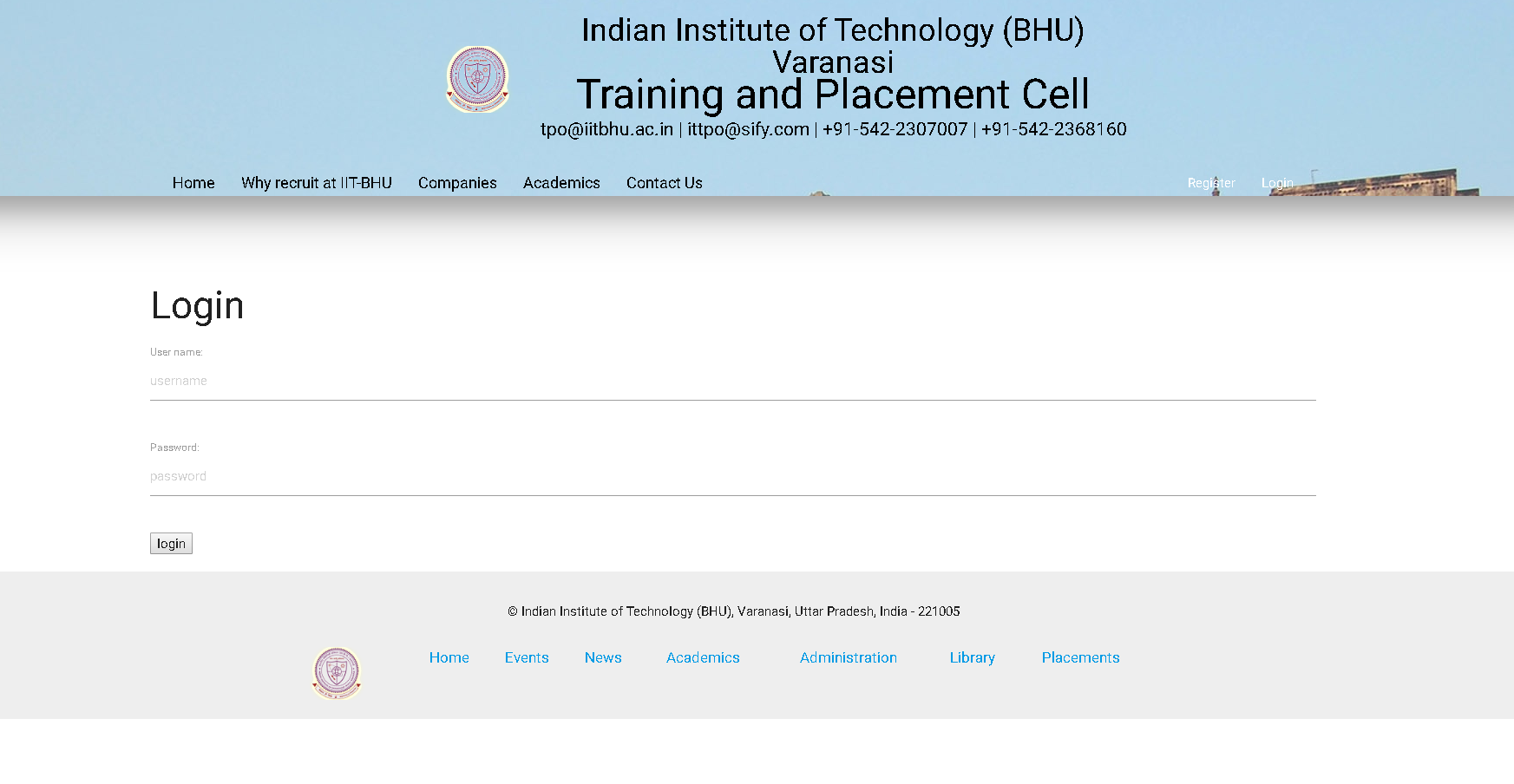
Log-in View of the website:

Slide 6
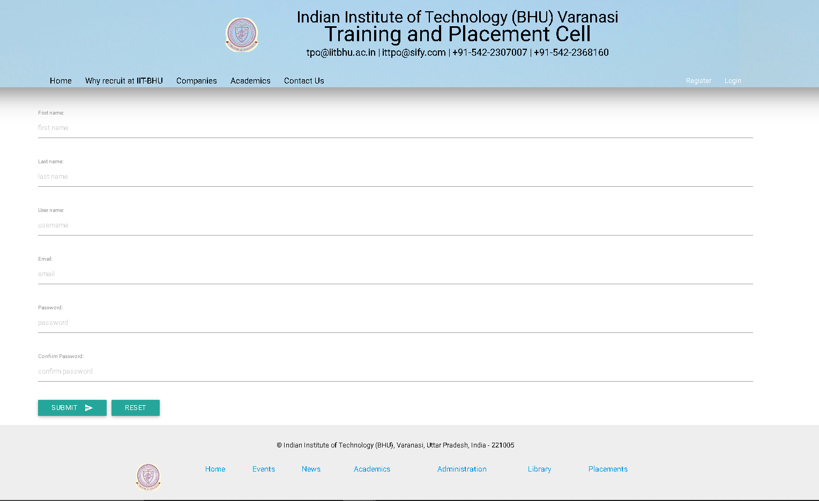
Register view of the website:

Slide 7
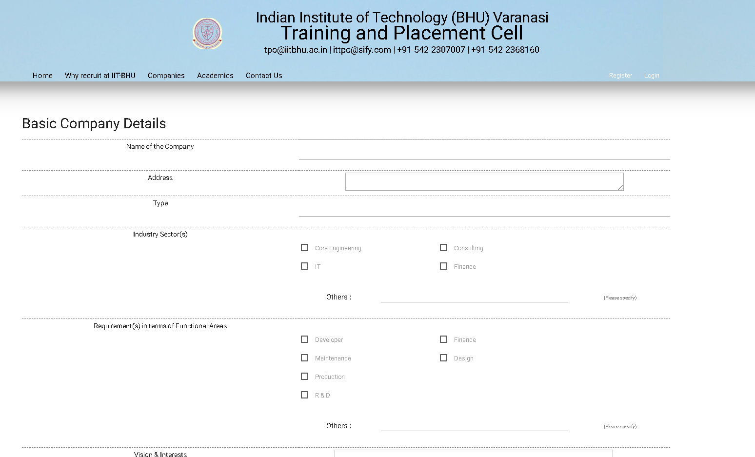
View of Company-Response-form:

Slide 8
Backend information in Brief:
We have adopted Django Framework for developing the website.
It handles the ‘behind-the-scenes’ functionality of web applications
It connects the web to a database, manages user connections, and powers the web application itself.
In views.py file, we have put the logic of our code,It will request information from model before and pass it to template.
In urls.py file we have set the patterns that Django will try to match the requested URL to find the correct view.

Slide 9
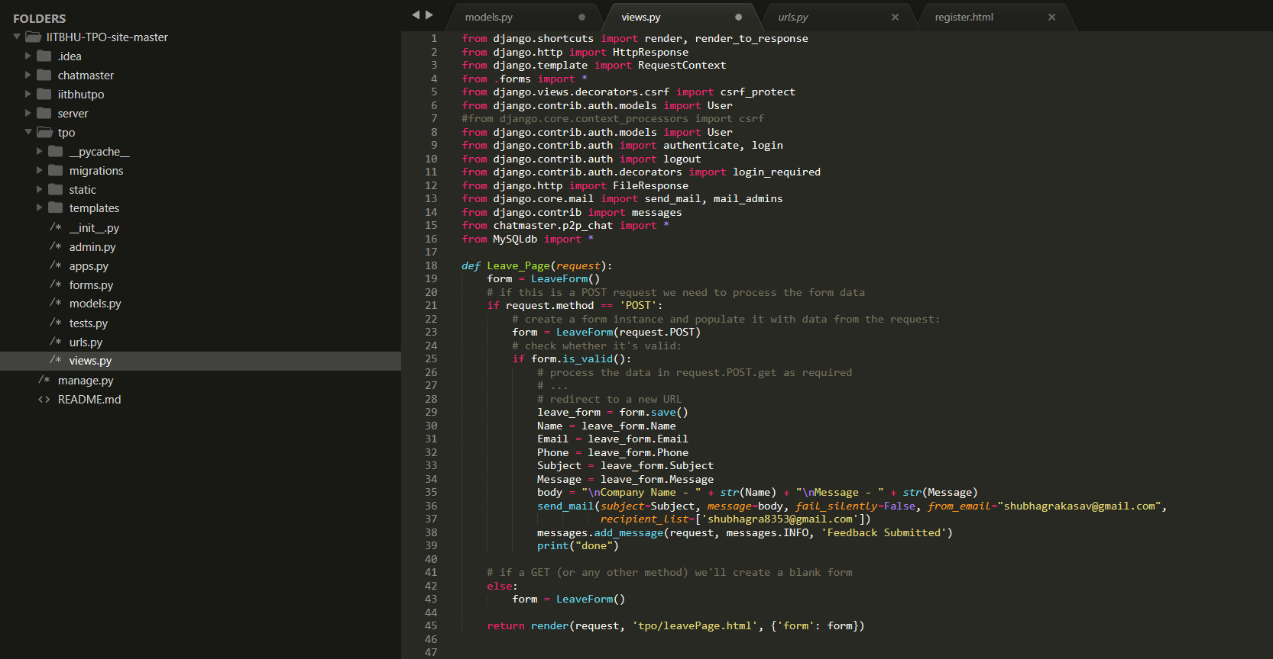
views.py file:

Slide 10
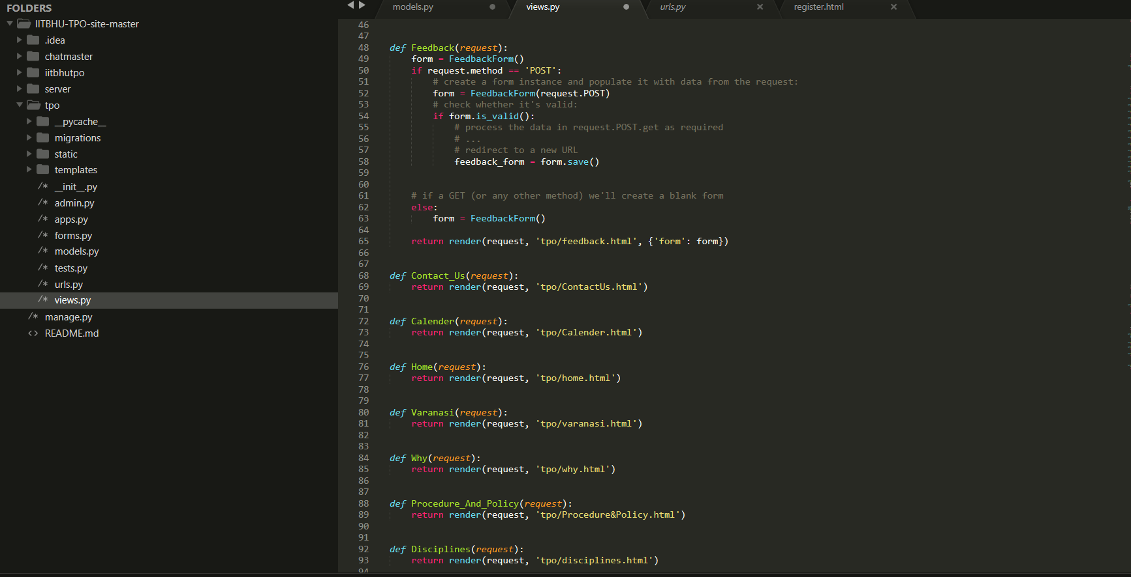
views.py file(continued):

Slide 11
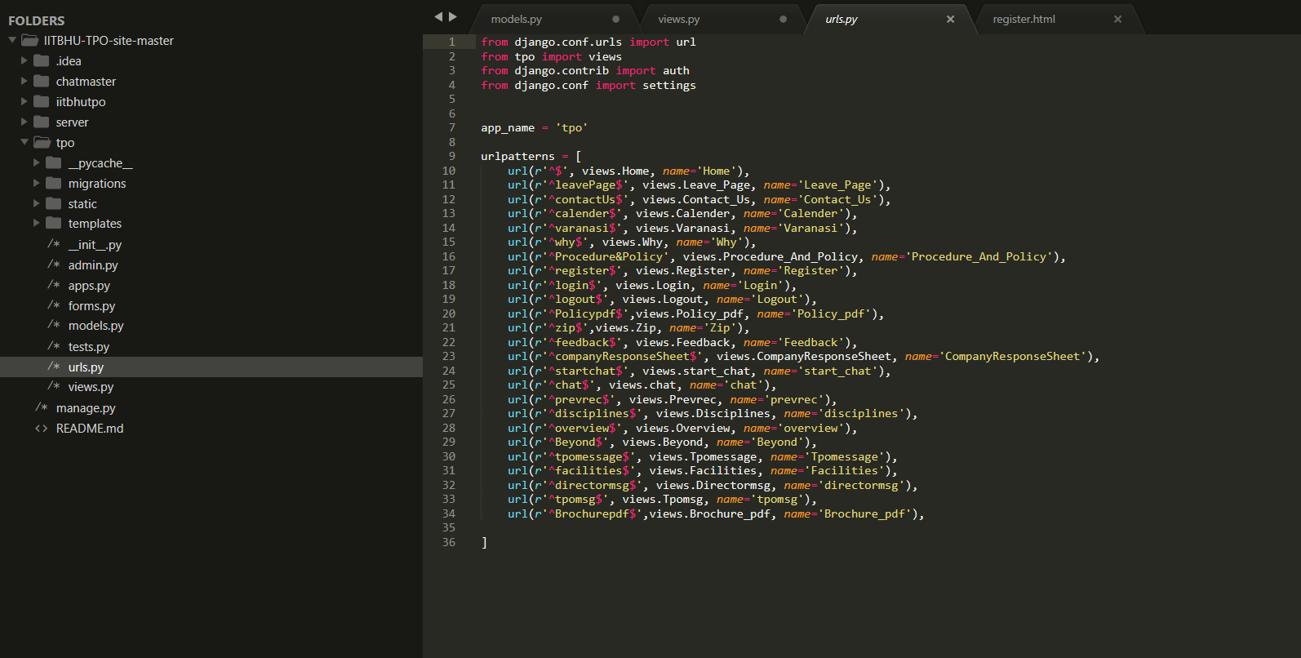
urls.py file:

Slide 12
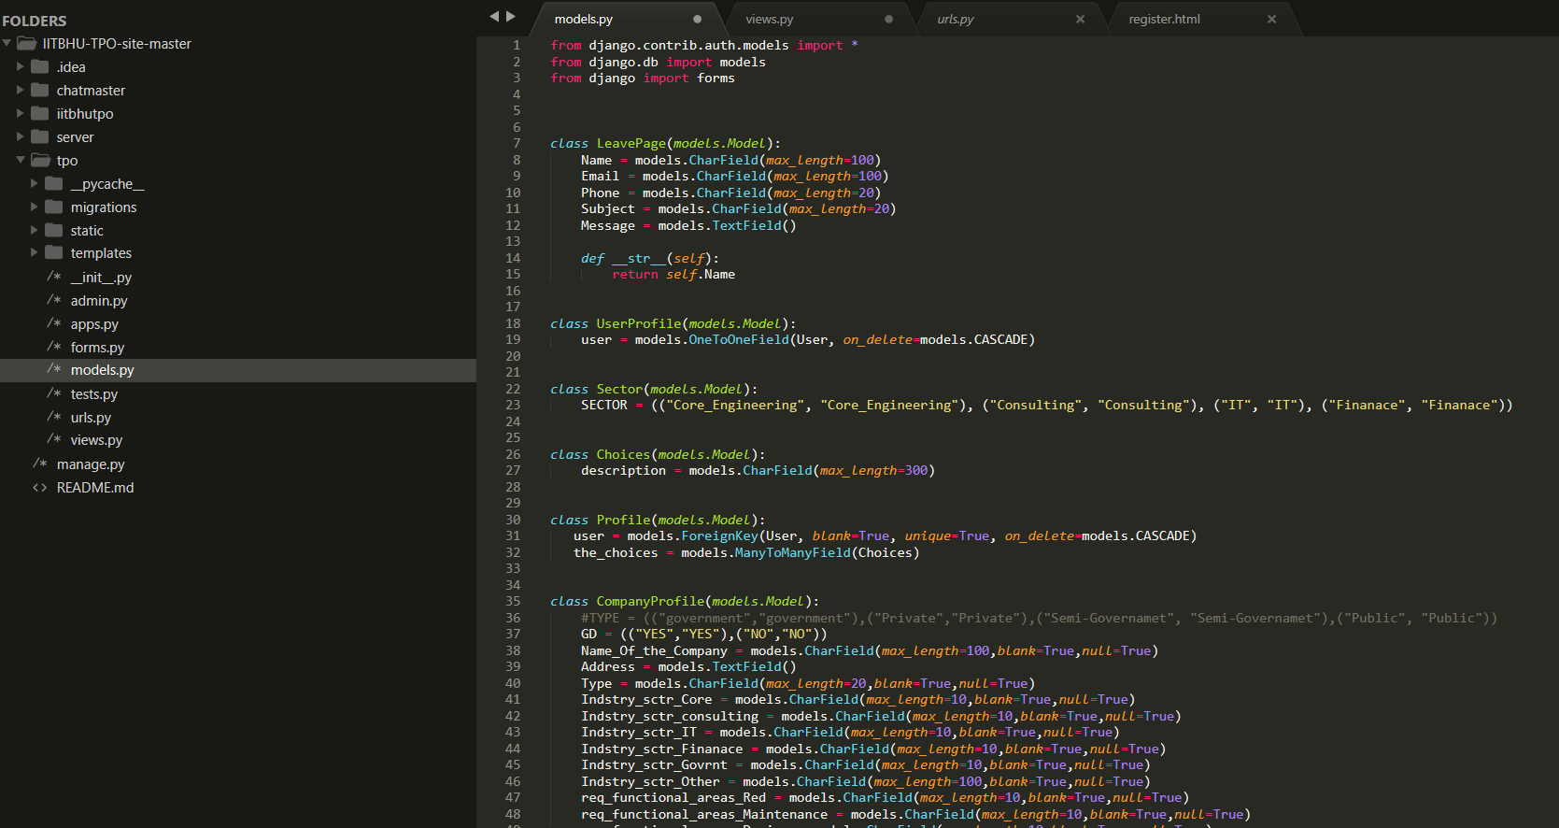
Models.py file :

Slide 13
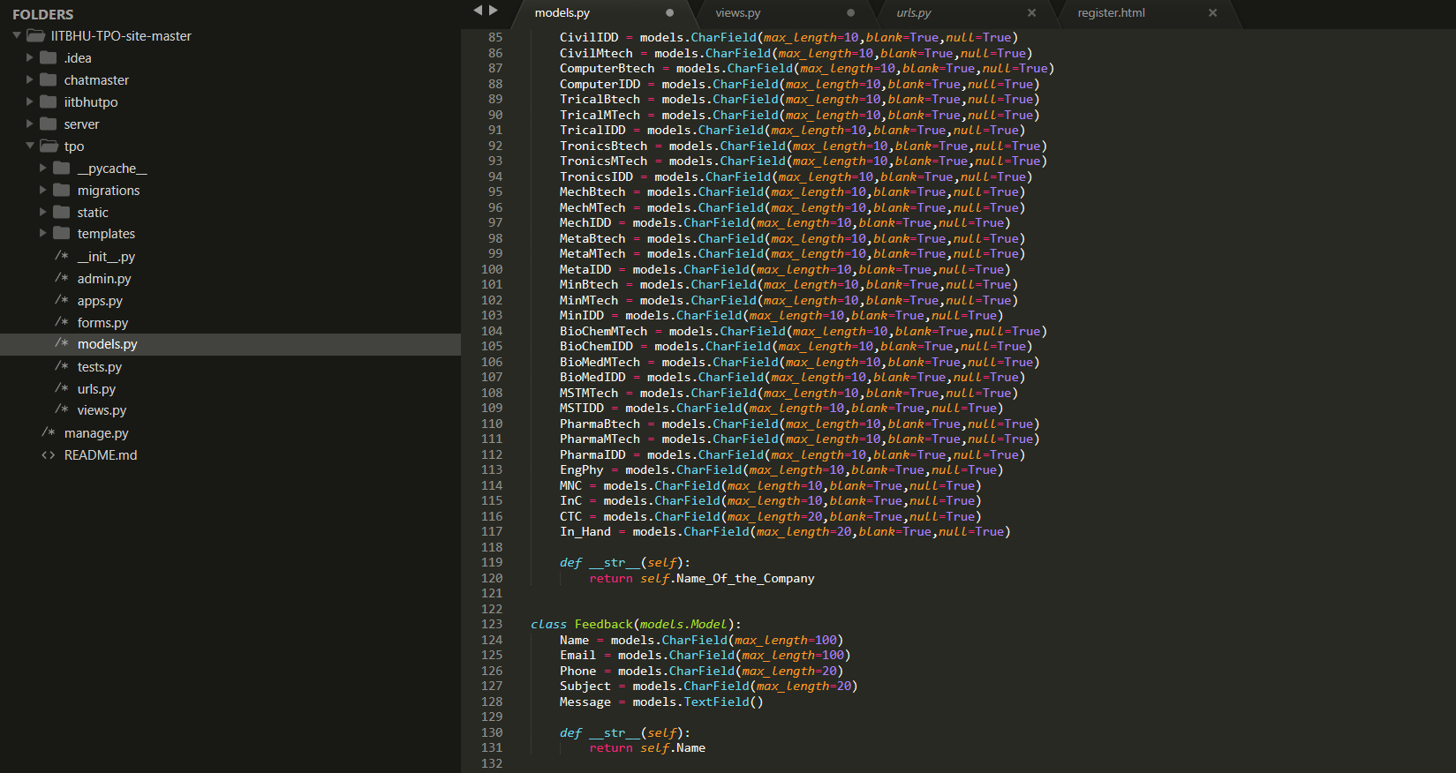
Models.py file(continued):

Slide 14
THANK YOU

